Slide 1
Rajaguru Stores POS System
Project Proposal

Slide 2
GROUP NO : 05
Dhanuka Abeywardhane (Team Leader)
Hansana Jayathissa
Samitha Rajaguru
Devindri Gunawardane
Navin Keerthirathna
Thanula Ramasinghe
Yashan Tharindu

Slide 3
CONTENT
Introduction and Description of Project
Objectives
Procedures
Requirements
Budget
References

Slide 4
INTRODUCTION
This project is a Point Of Sale System. We are making this project for the Rajaguru Stores [pvt] Ltd.
It is a grocery shop which is focusing to supply customer requirements using an online system and a POS system.
We are mainly targeting to satisfy our client and make the software which our client actually expects.
Notes:
Malabe
Manual
Hoyagathe member kenekgen

Slide 5
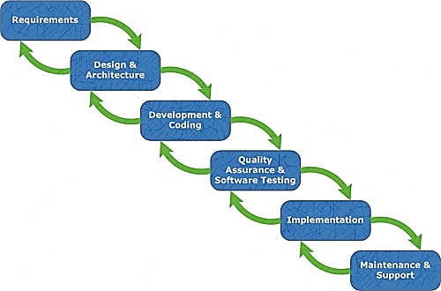
Description of the Project

Slide 6
Stock Handling System
Stock handling System
Supplier details
Billing System
Online order system

Slide 7
Problems that can be occurred
To manage the billing and store items since the count of the items increase.
To find the quantity of sold items and the profit of them.
To determine the change in the quantity of the store item.
To summarize the Expenditure, Profit and Loss.
Taking more time in the manual system.

Slide 8
Solutions
Customer privileges
Employee privileges
Accuracy and Efficiency

Slide 9
Key Benefits
1
Information security
2
Data storage
3
Time is saved, increase in transaction Speed and make the work easy.
4
Profit increase

Slide 10
OBJECTIVES
Our goal is to satisfy the client’s requirements to the maximum.
Our intension is to give efficient and productive, client friendly system.
To limit the errors within the manual system.
To give reliable information about data and maximum security for the database where data within the system cannot be access by any third party.
To aware the client about the items that is out of stock. Also to warn about the expired items.
To do many transactions within a short time.
To indicate the profit, loss, expenditure, special offer, discounts, within the store.

Slide 11
Functions
Supplier Details
GRN System
Stock Management
Notification System
Billing System
Online Customer Registration and Login System
Online Ordering System

Slide 12
PROCEDURES
Feasibility Study
Requirement Analysis
System Analysis
System Design
Implementation and Unit Testing
Software and web interface designing
Database Designing
Schedule Feasibility
Economic Feasibility
Technical Feasibility

Slide 13
HARDWARE AND SOFTWARE REQUIREMENTS
2.0 GHz processor with 2MB L2 cache Memory 2GB DDR III RAM Memory
50 GB HDD
Web server
PHP, SQL, DNS server, Mail server
Basic
To implement this grocery System does not need a very high end machine. However
broadband internet connection is suggested to gain a good performance
Requirements
Hardware
Operating system (Linux, Windows, Mac OS)
Any kind of Browser
MySQL version 5.6.20
Xampp 1.8.3-3-VC11- server
Software

Slide 14
BUDGET

Slide 15
REFERENCES
PHP manual (www.php.net/docs.php)
PHP tutorials from following site.
www.w3schools.net
www.php.net
YOU TUBE (www.youtube/newboston)
Lynda.com
Library books & E-books

Slide 16
THANK YOU

